Slide 1
Data Structures and Algorithms -3 (25CS2103E)
Intelligent Spell Checker Using Levenshtein Edit Distance
Team Members
Yeshvitha – 2520030194
Bhavyanshi – 2520030038
Spandana - 2520030160
Under the Esteemed Guidance of
Name of the DSA-3 faculty name with designation and department

Slide 2
Contents
Abstract
Introduction
Literature survey
Problem Statement and Objectives
Hardware and Software requirements
Results
Conclusion
Future Scope

Slide 3
Abstract
Core Objective: Develop an intelligent spell checker that detects misspelled words and generates ranked correction suggestions using Levenshtein Edit Distance.
Operation Set: Computes the minimum number of character-level operations—Insertion, Deletion, and Substitution—required to transform input strings.
Ranking Mechanism: Ranks candidate words dynamically; dictionary terms with lower edit distances receive top suggestion priority.
Practical Utility: Highly efficient and lightweight solution adaptable for search engines, text editors, and Natural Language Processing (NLP) systems.

Slide 4
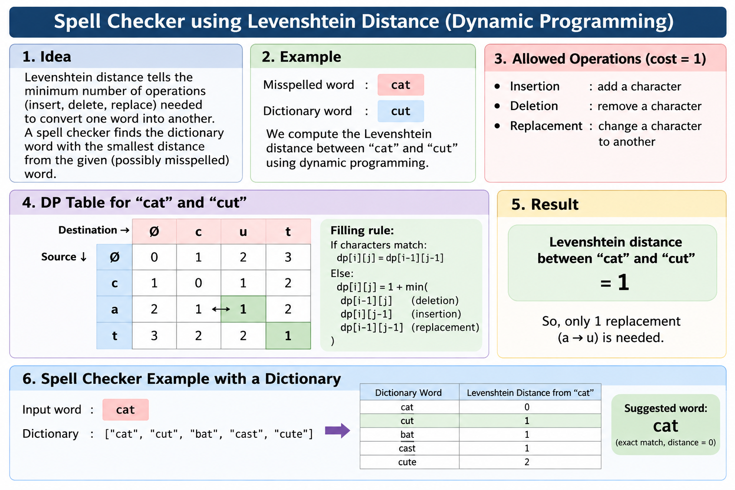
Introduction
Background: Real-time text processing tools require accurate spelling detection and automated candidate suggestions.
Core Concept: Levenshtein Edit Distance quantifies how different two string sequences are by measuring the minimum edits needed to transform one into another.
Application Scope: Essential component in Natural Language Processing (NLP), autocomplete systems, and search query refinement.

Slide 5
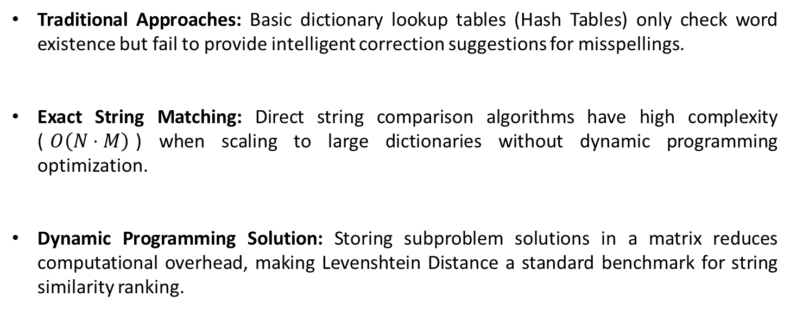
Literature Survey
Traditional Approaches: Basic dictionary lookup tables (Hash Tables) only check word existence but fail to provide intelligent correction suggestions for misspellings.
Exact String Matching: Direct string comparison algorithms have high complexity ($O\left(N⋅M\right)$) when scaling to large dictionaries without dynamic programming optimization.
Dynamic Programming Solution: Storing subproblem solutions in a matrix reduces computational overhead, making Levenshtein Distance a standard benchmark for string similarity ranking.

Slide 6
Problem Statement and Objectives
Problem Statement: Text input systems frequently encounter typographical errors, necessitating an efficient mechanism to accurately identify errors and suggest appropriate corrections in real time.
Objectives:
  Implement the Levenshtein Edit Distance algorithm using dynamic programming.
  Map input terms against a predefined dictionary to calculate minimum transformation operations.
  Rank candidate replacement words based on edit distance thresholds.
  Provide a scalable foundation for text processing and NLP applications.

Slide 7
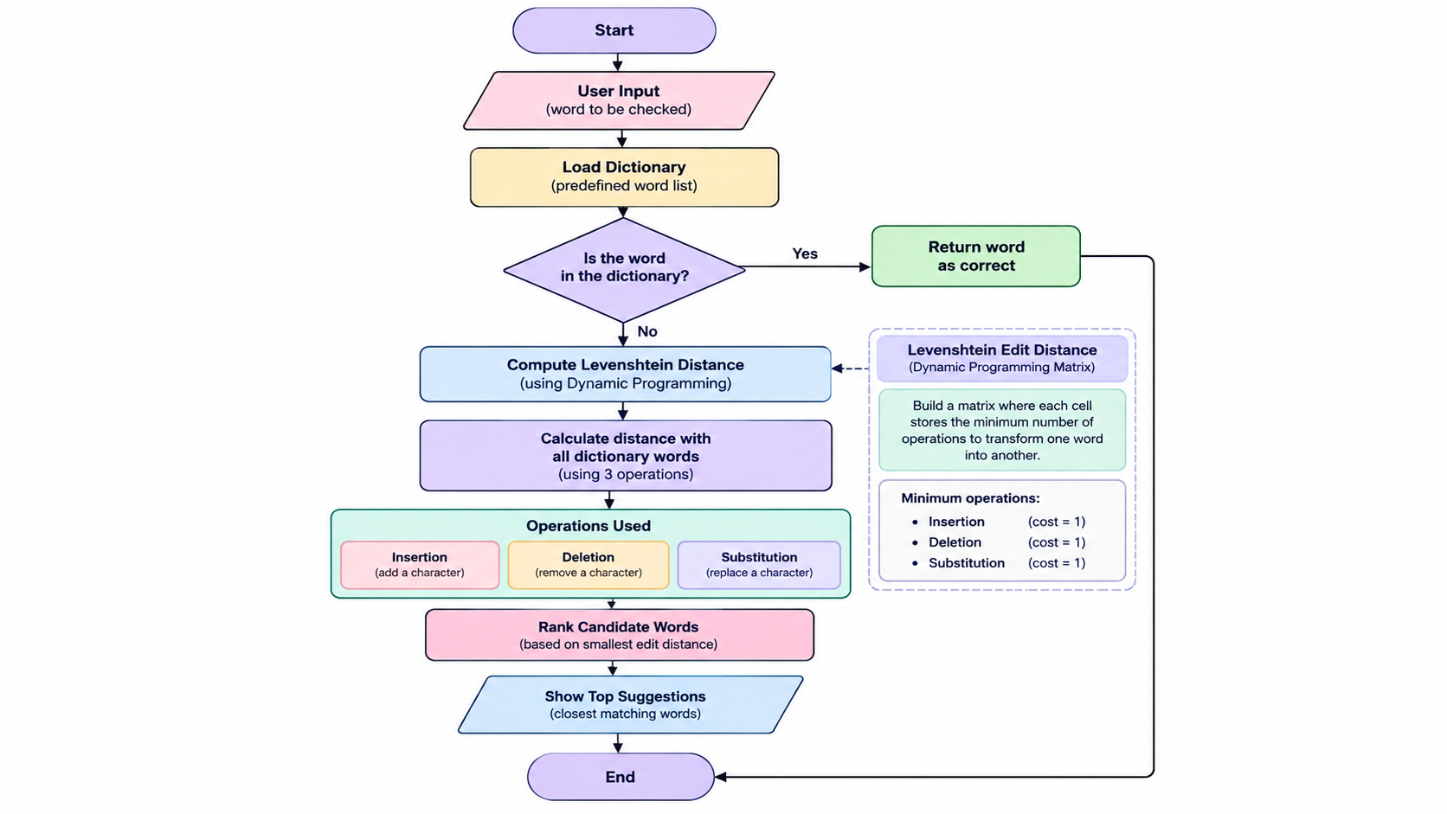
Flow Chart

Slide 8
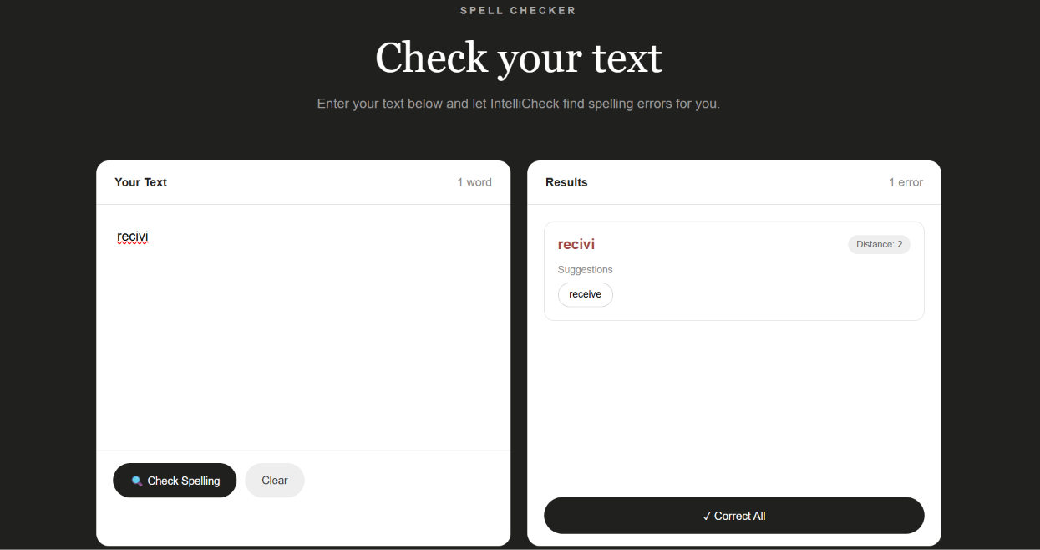
Results

Slide 9
Conclusion
High Precision : Levenshtein Edit Distance accurately identifies character insertions, deletions, and substitutions to recommend correct spelling options.
Algorithmic Efficiency : Dynamic Programming reduces duplicate sub-problem computations, converting exponential brute-force string alignment to efficient time limits.
Versatile Integration : Serves as a robust component suitable for text editors, auto-correct keyboards, search query normalization, and NLP ingestion engines.

Slide 10
Future Scope
Context-Aware Correction: Integrate N-Gram language models or Transformer LLMs to resolve contextual misspellings (e.g., "I went to the sea/see").
Keyboard Spatial Distance: Incorporate QWERTY key proximity weighting into substitution cost functions.
Hybrid Phonetic Distance: Combine Levenshtein distance with Double Metaphone or Soundex algorithms to catch phonetic phonetic errors.
Multilingual Expansion: Support multi-language dictionaries and UTF-8 script processing for global language spell-checking.

Slide 11
Thank you

